Slide 1
Convolutional Neural Networks (CNNs)
Convolutional Neural Networks (CNNs)
Notes:
Introduction to the presentation on Convolutional Neural Networks (CNNs).

Slide 2
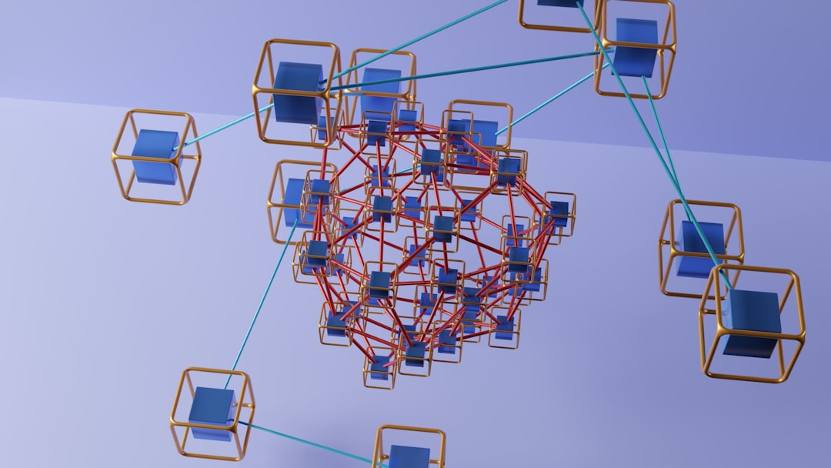
Introduction to CNNs
CNNs are neural networks designed to process grid-like data such as images
They automatically learn spatial hierarchies of features from raw pixels
Convolutions capture local patterns like edges, textures and shapes

Slide 3
Convolution Operation
A kernel (filter) slides over the input computing weighted sums
Same weights are reused across the spatial dimension, reducing parameters
Stride and padding control output size and receptive field

Slide 4
Pooling Layers
Pooling downsamples feature maps to reduce spatial size and computation
Max pooling keeps the most activated value within a window
It provides translation invariance and reduces overfitting

Slide 5
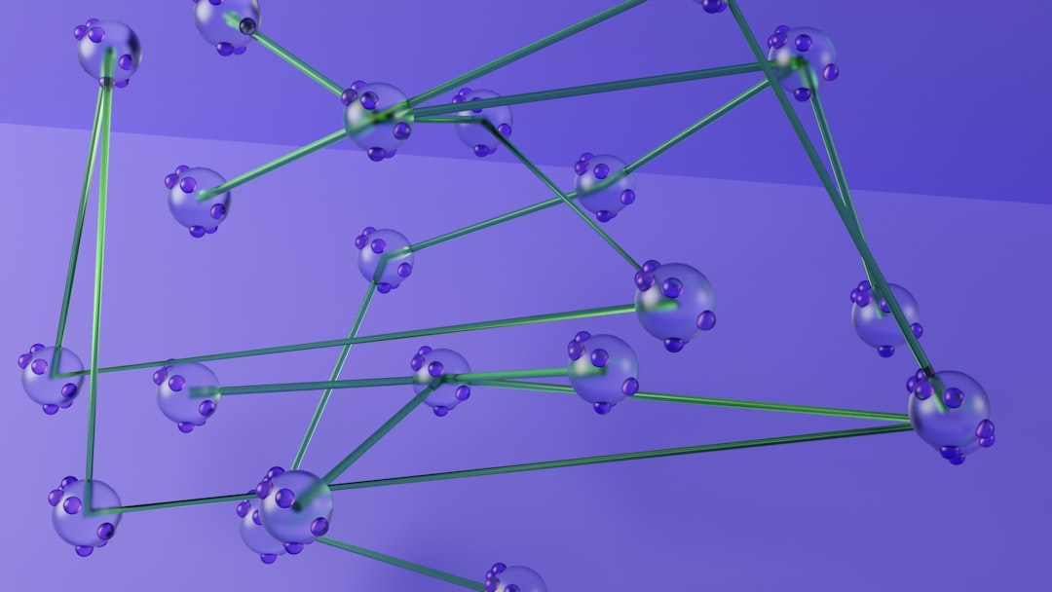
CNN Architecture Example
Typical CNN: Conv → ReLU → Pool blocks followed by fully connected layers
Deeper architectures like VGG, ResNet stack many such blocks
Output layer uses softmax for multi-class classification

Slide 6
Applications of CNNs
Image classification, object detection, segmentation and face recognition
Medical image analysis and autonomous driving perception
Document understanding and scene text recognition

